Slide 1

Data Analysis on TMDB Movie data
RAGUL S

Slide 2

Objective
The Objective of the project is to use Python Programming to analyze a movie data to perform exploratory data analysis. The production company wants to analyze a movie dataset to understand the factors that contribute to commercial success and high ratings. By examining patterns and trends in the data, the company hopes to identify which genres tend to perform well at the box office and other key drivers of success.
Here we have to use python programming to analyze the data to perform exploratory data analysis by answering the questions in the upcoming slides.

Slide 3

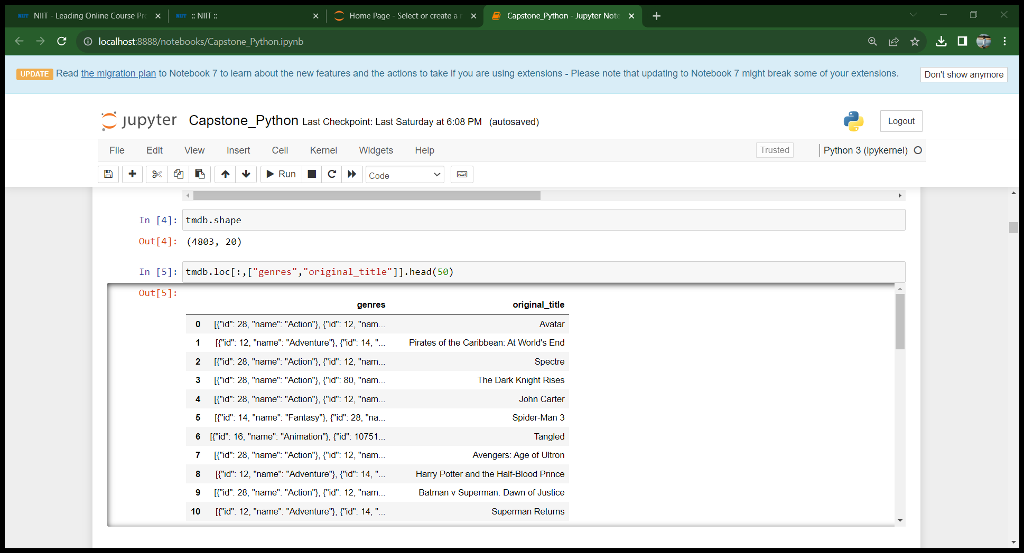

Task 1 Load the dataset in the python notebook and display the number of rows and columns in the data set. Display the title and genres for the first 50 movies in dataset
Number of rows : 4803
Number of Columns: 20

Slide 4

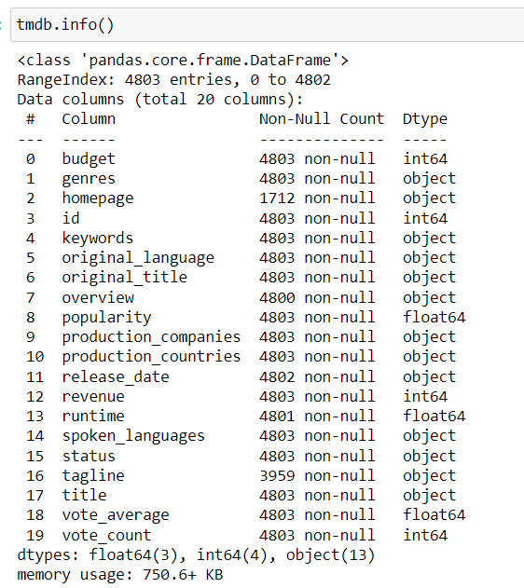
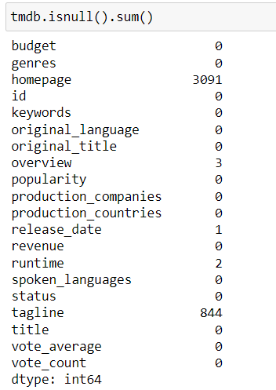
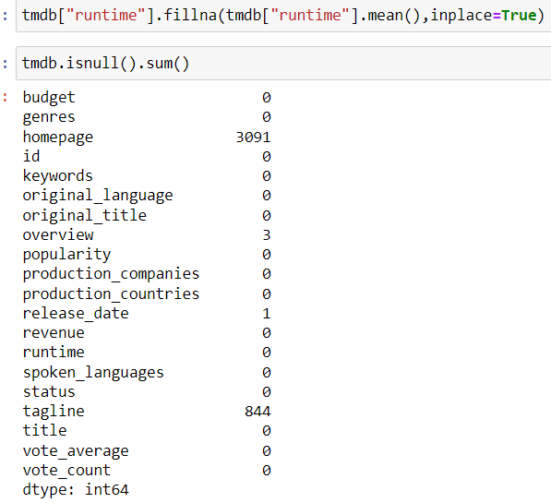
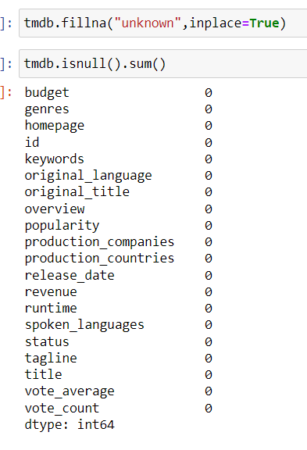
Task 2
Identify the columns that have null values and Perform the null value treatment
Homepage , Overview , release date, tagline columns have null values
Treatment:
1.null values in runtime column by avg runtime
2.Rest of the columns I have replaced null values by a word “unknown” as imputing it will make the data more changed.

Slide 5
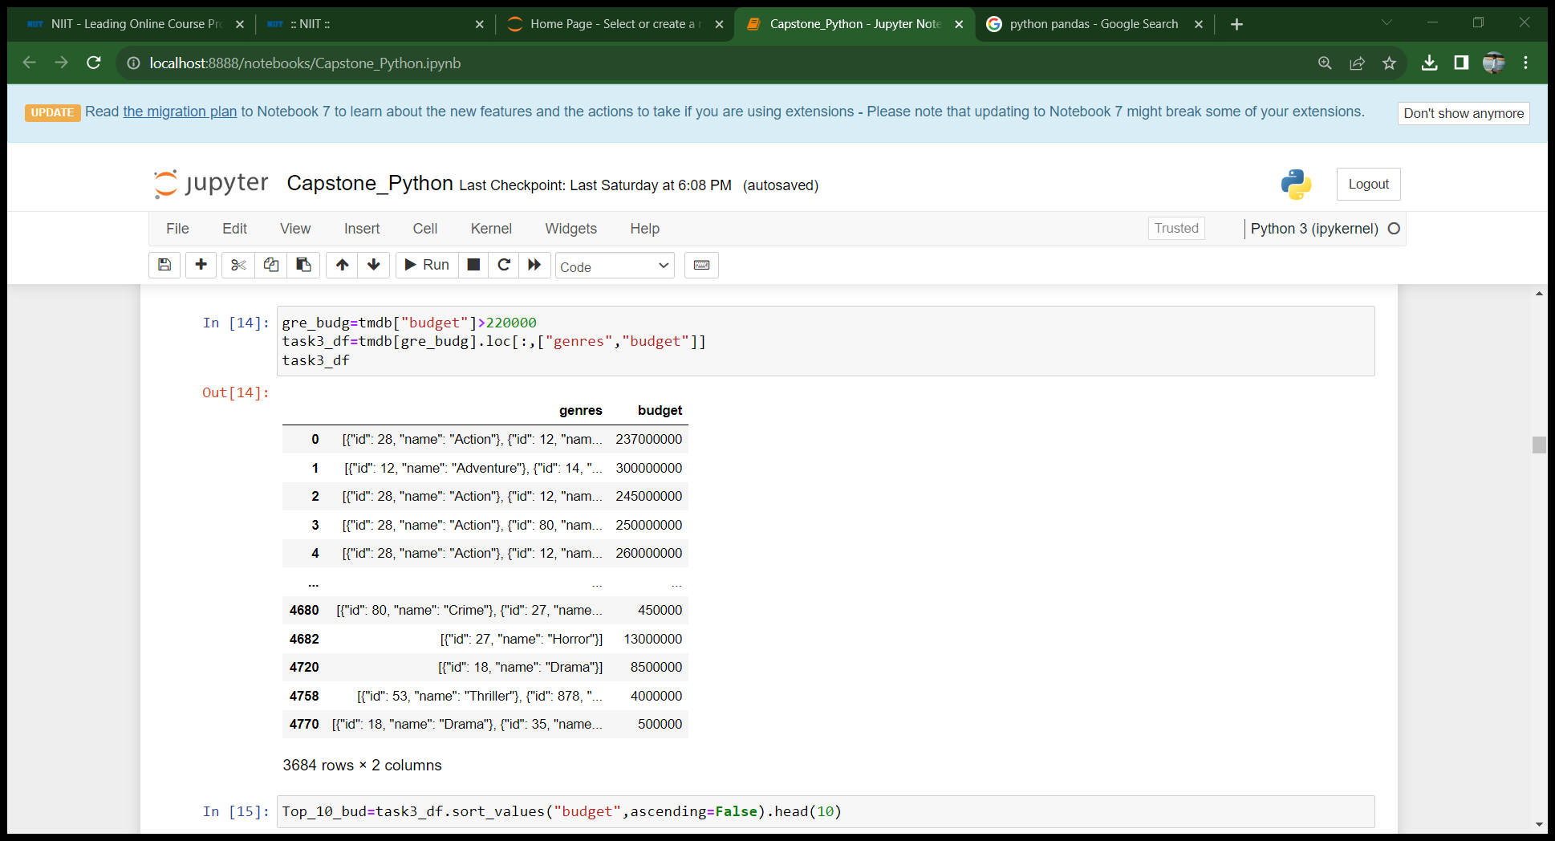

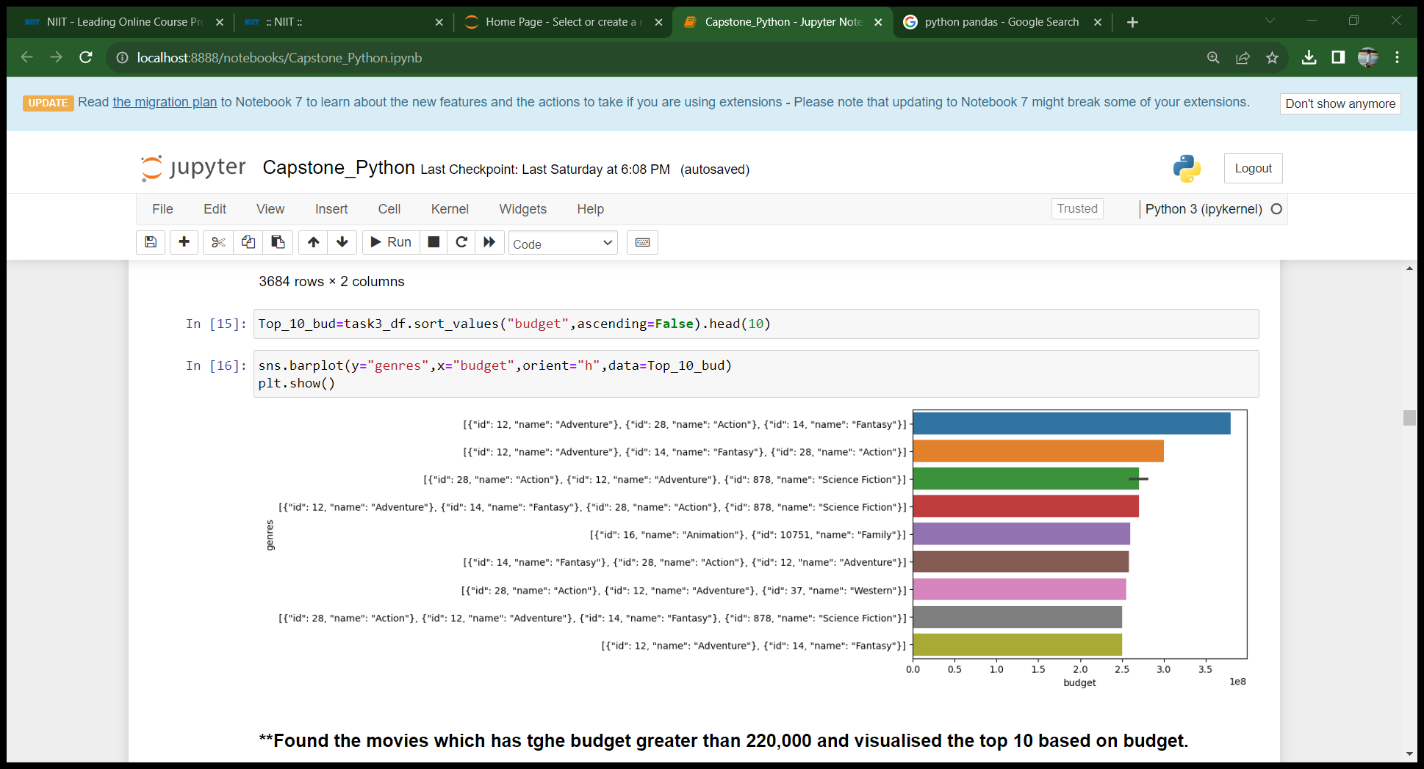

Task 3
Display the movie categories which that have a budget greater than $220,000
Number of records : 3684

Slide 6
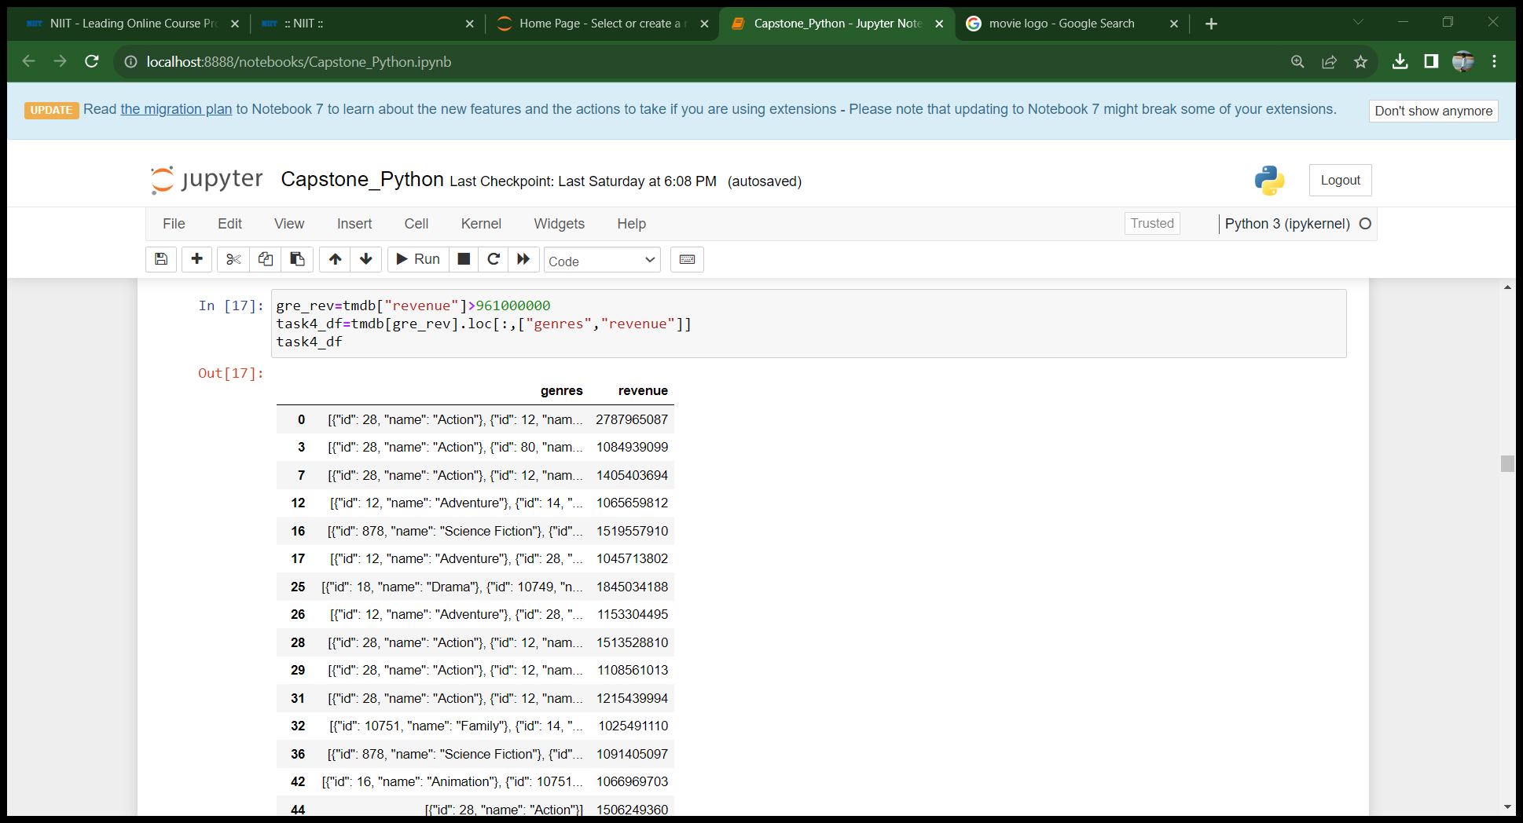

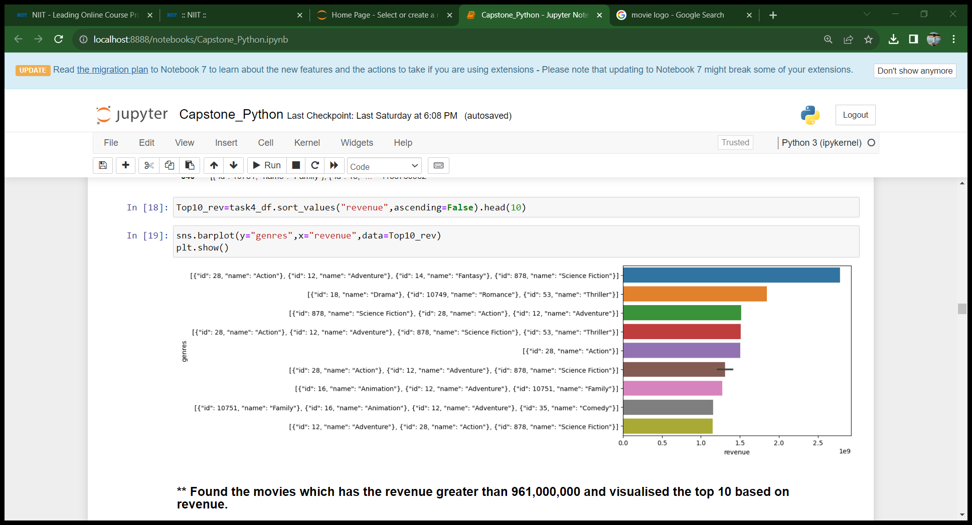

Task 4
Display the movie categories where the Revenue is greater than $961,000,000
Number of records : 24

Slide 7
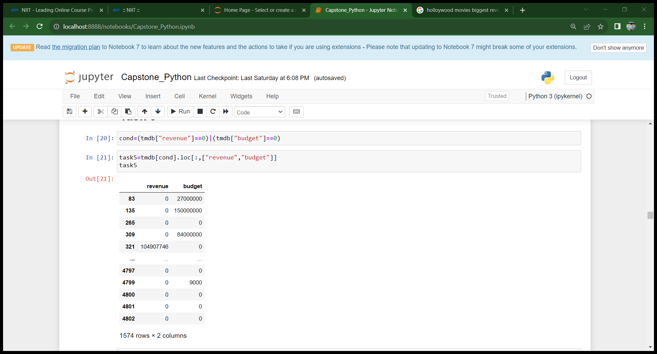
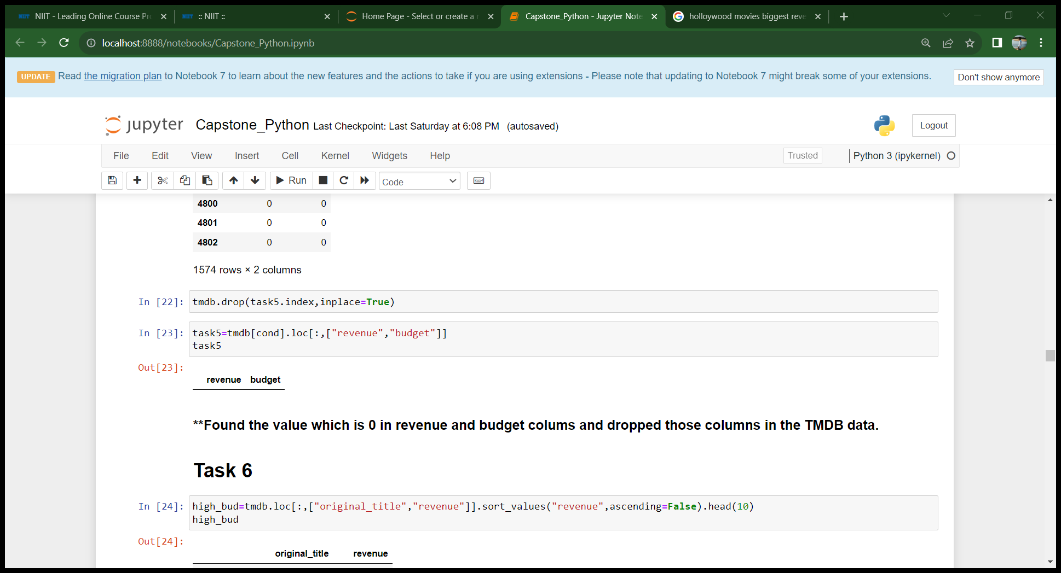

Task 5
In the dataset there are some movies for which the budget and revenue columns have the value 0 . Remove the rows with 0 on both budget and revenue columns
After dropping revenue and budget column which has 0…there are no record with 0 in those both columns.
Number of records : 1574

Slide 8
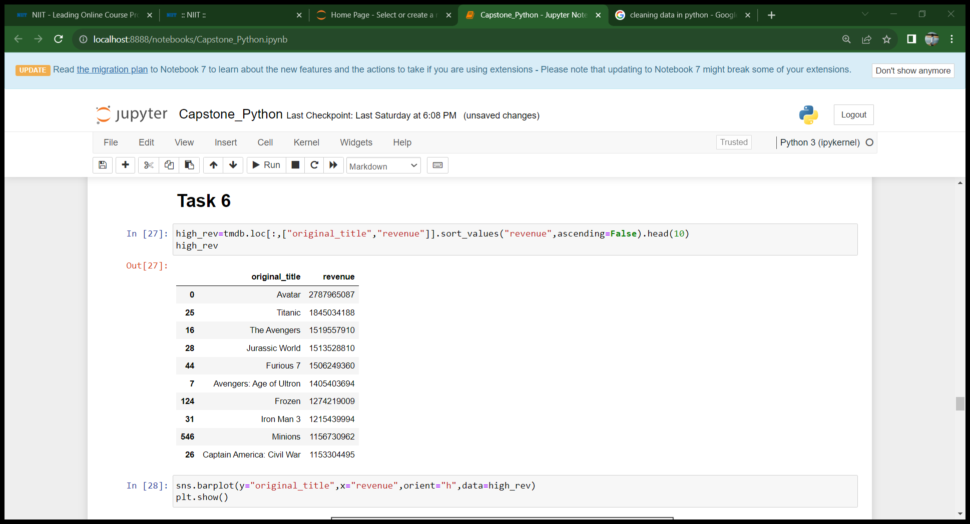
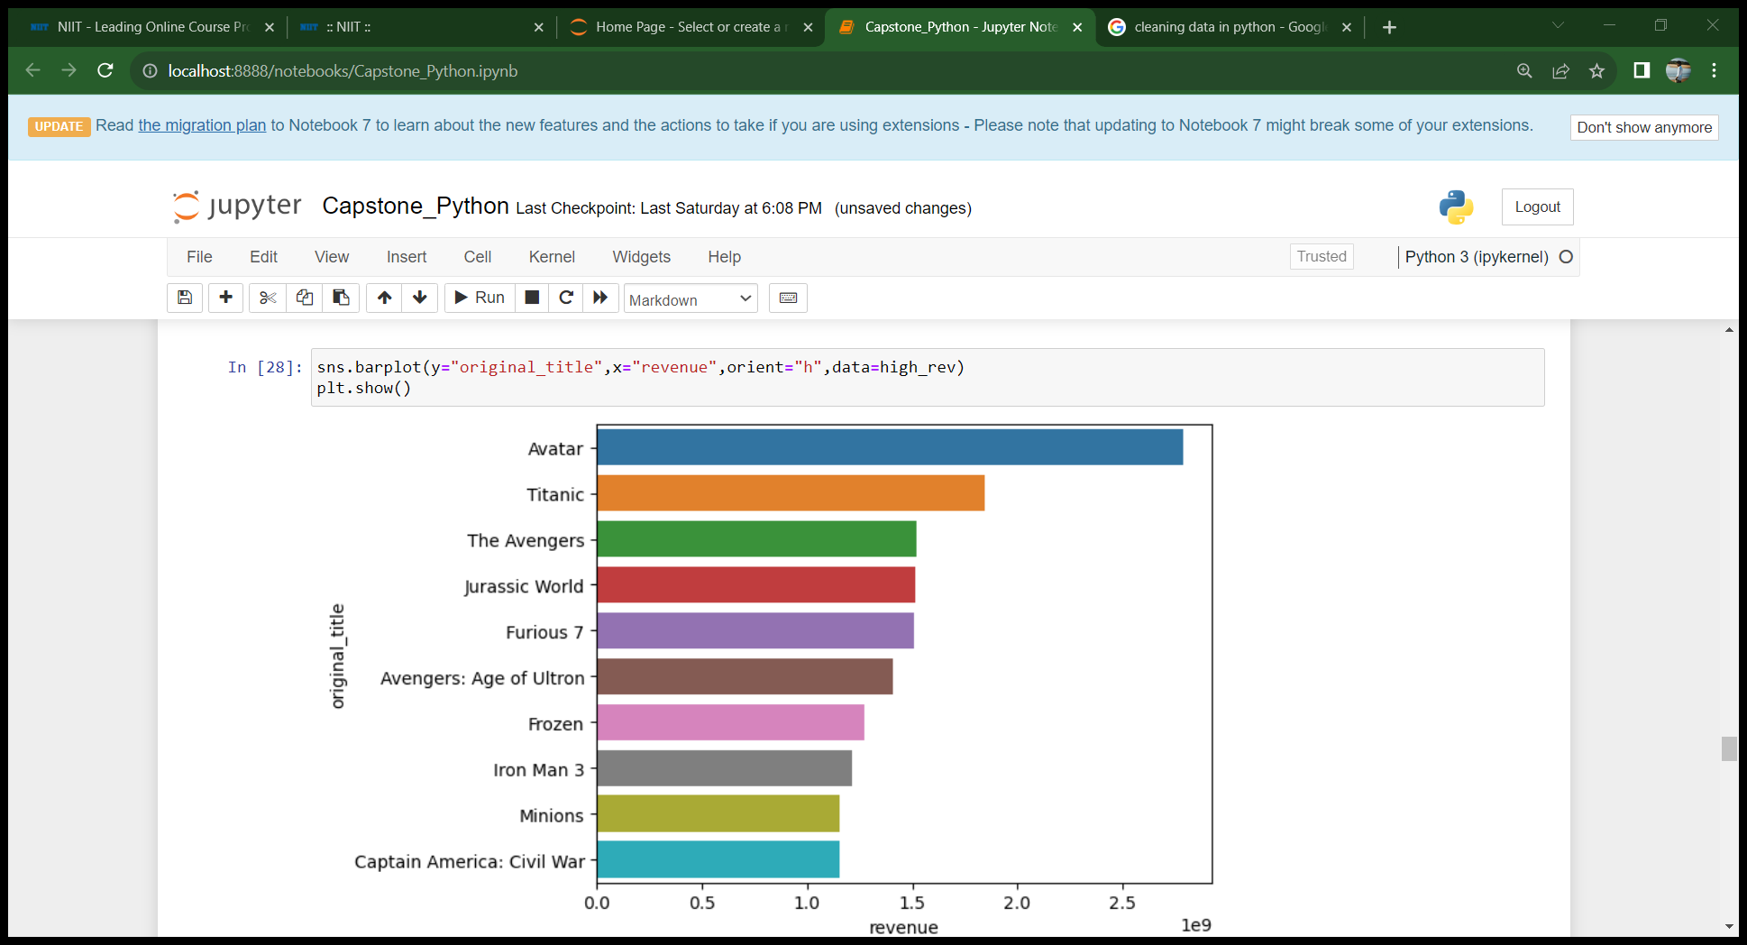

Task 6
A)List the top 10 movies with highest revenue
Avatar has the highest revenue

Slide 9
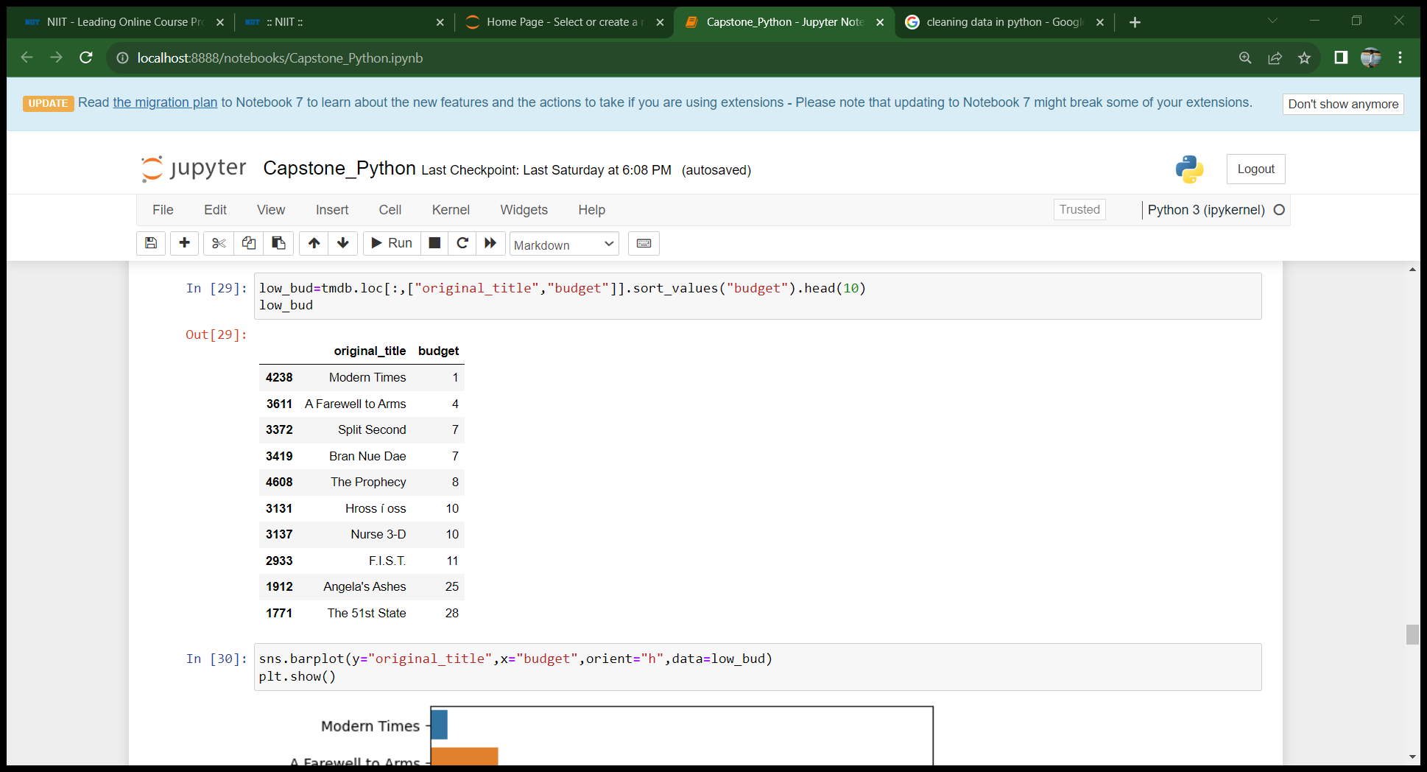
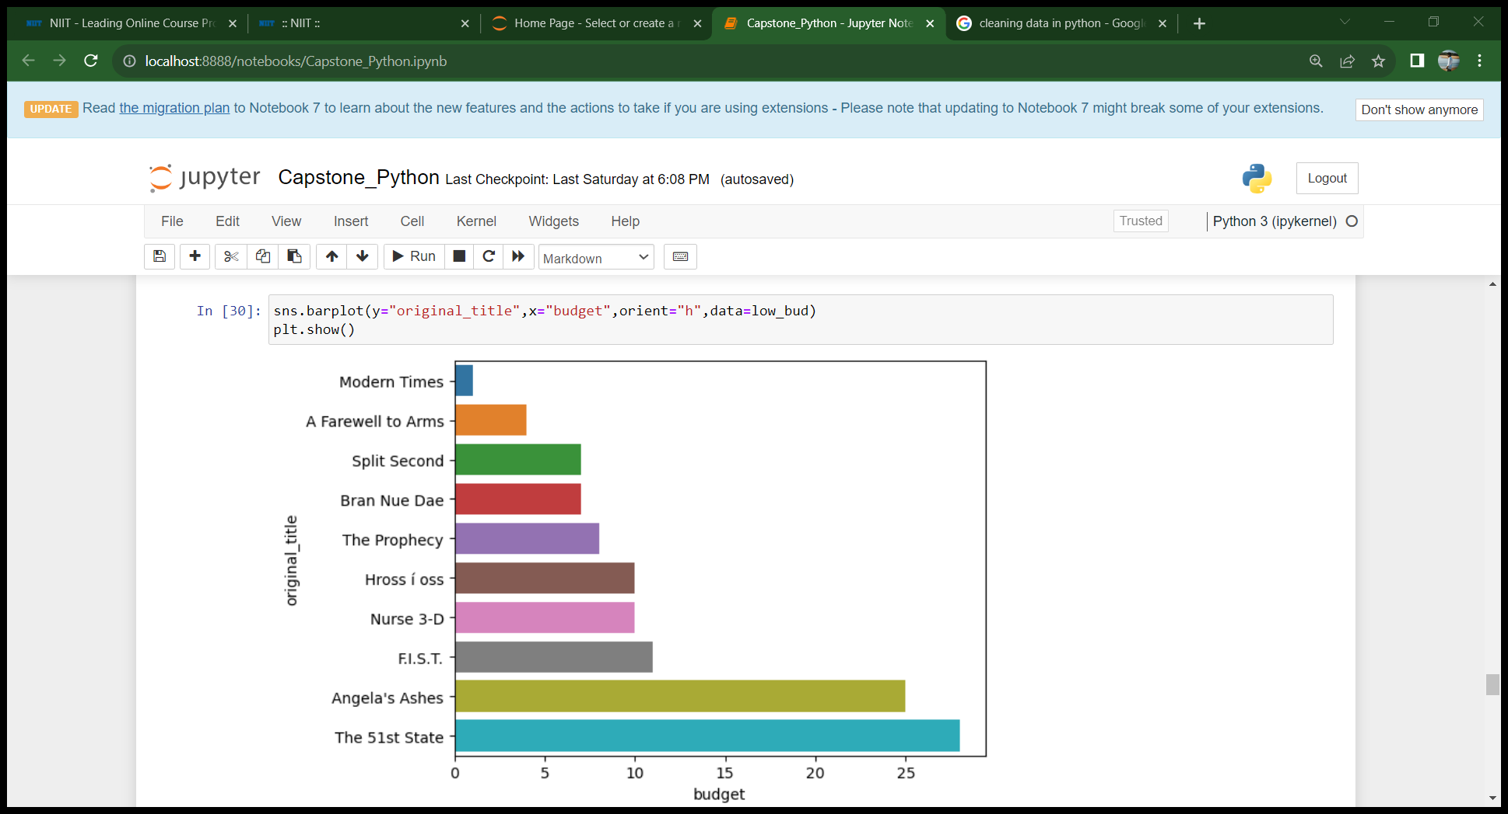

Task 6
B)List the top 10 movies with Least budget
Modern times has the lowest budget

Slide 10

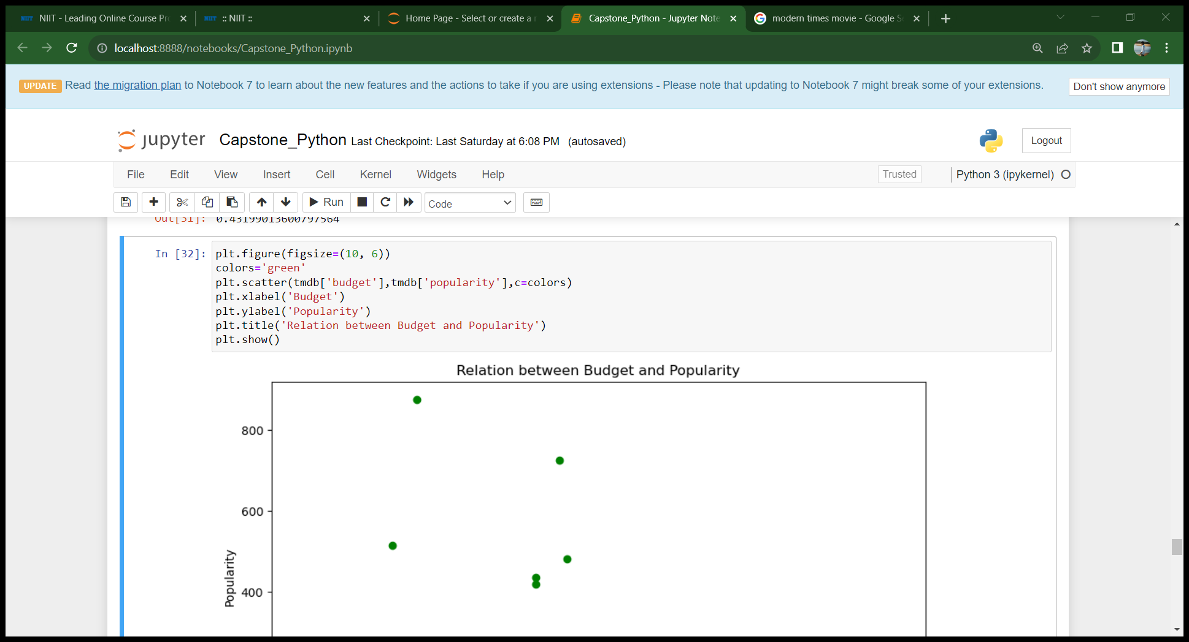
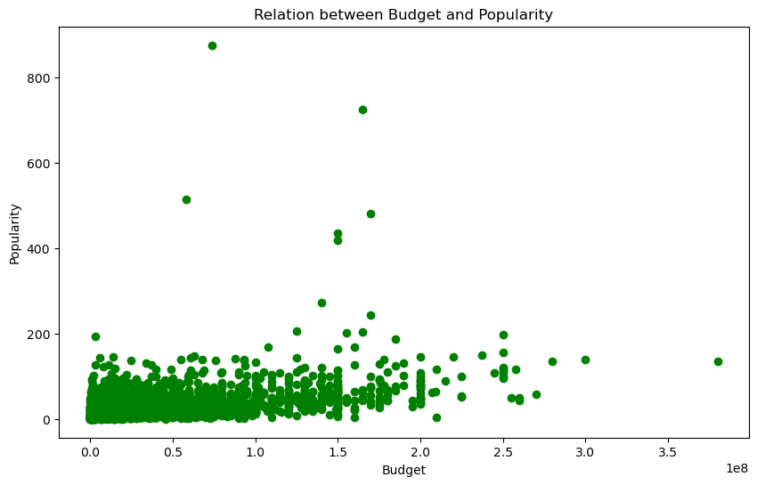
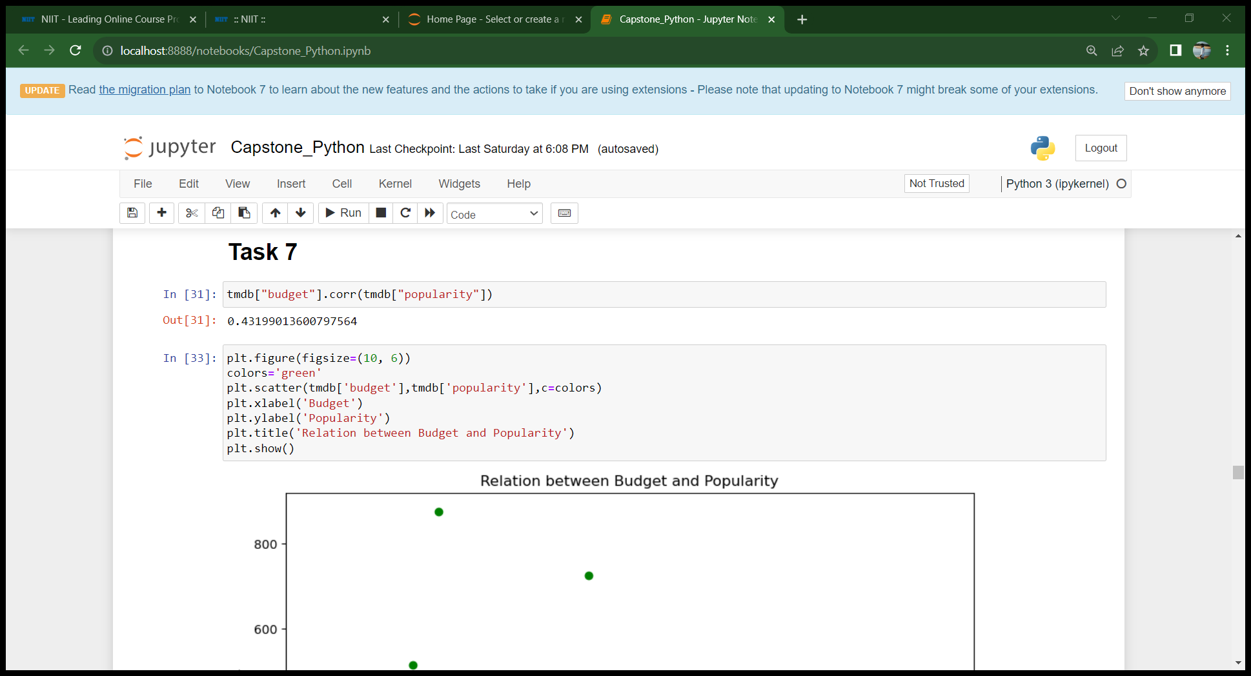
Task 7
How are popularities of movies related with the movie budgets ? Are they correlated or totally uncorrelated with each other?
Popularities and budgets have a positive correlation and a weak correlation

Slide 11

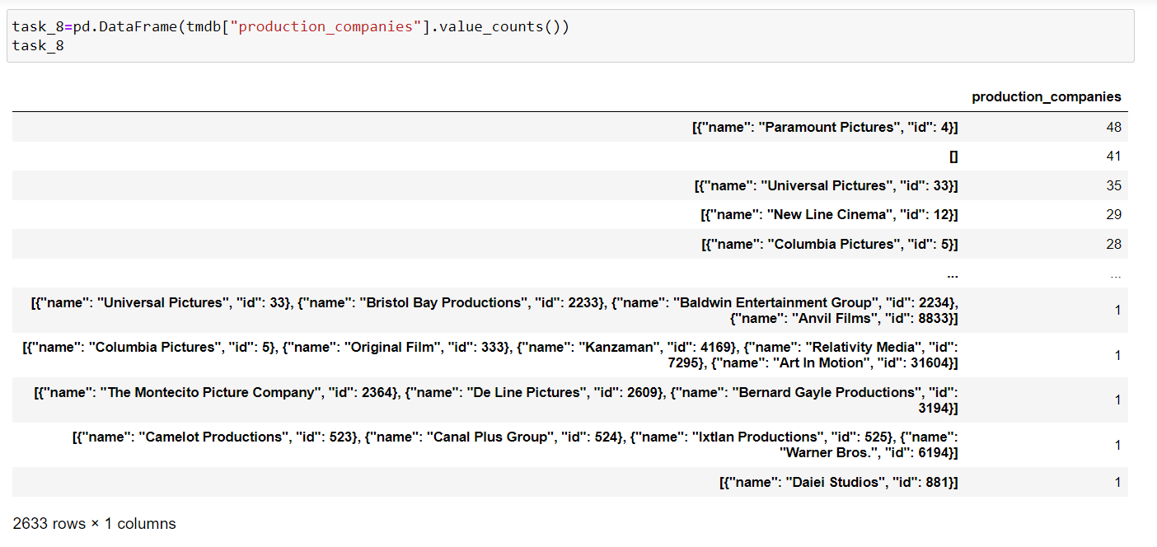

Task 8
Identify and display all the names of Production companies along with the number of times they appear in dataset.
Number of records : 2633

Slide 12
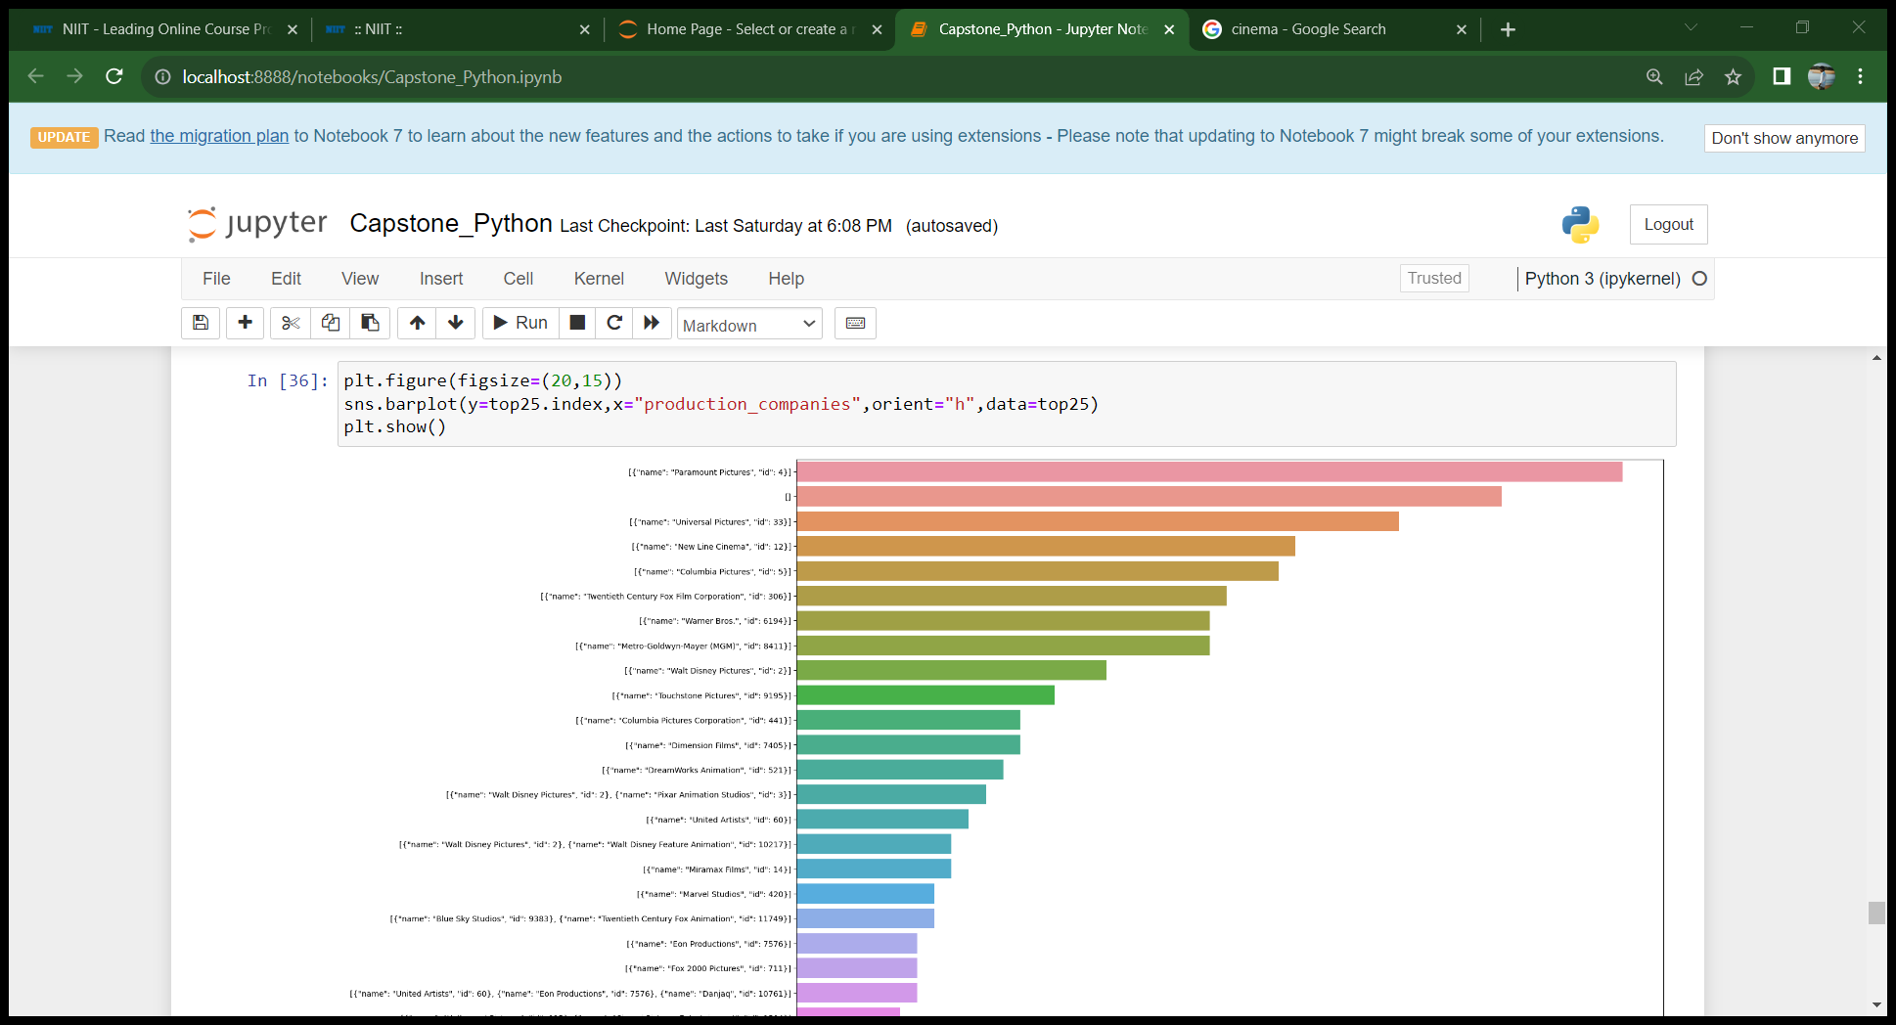
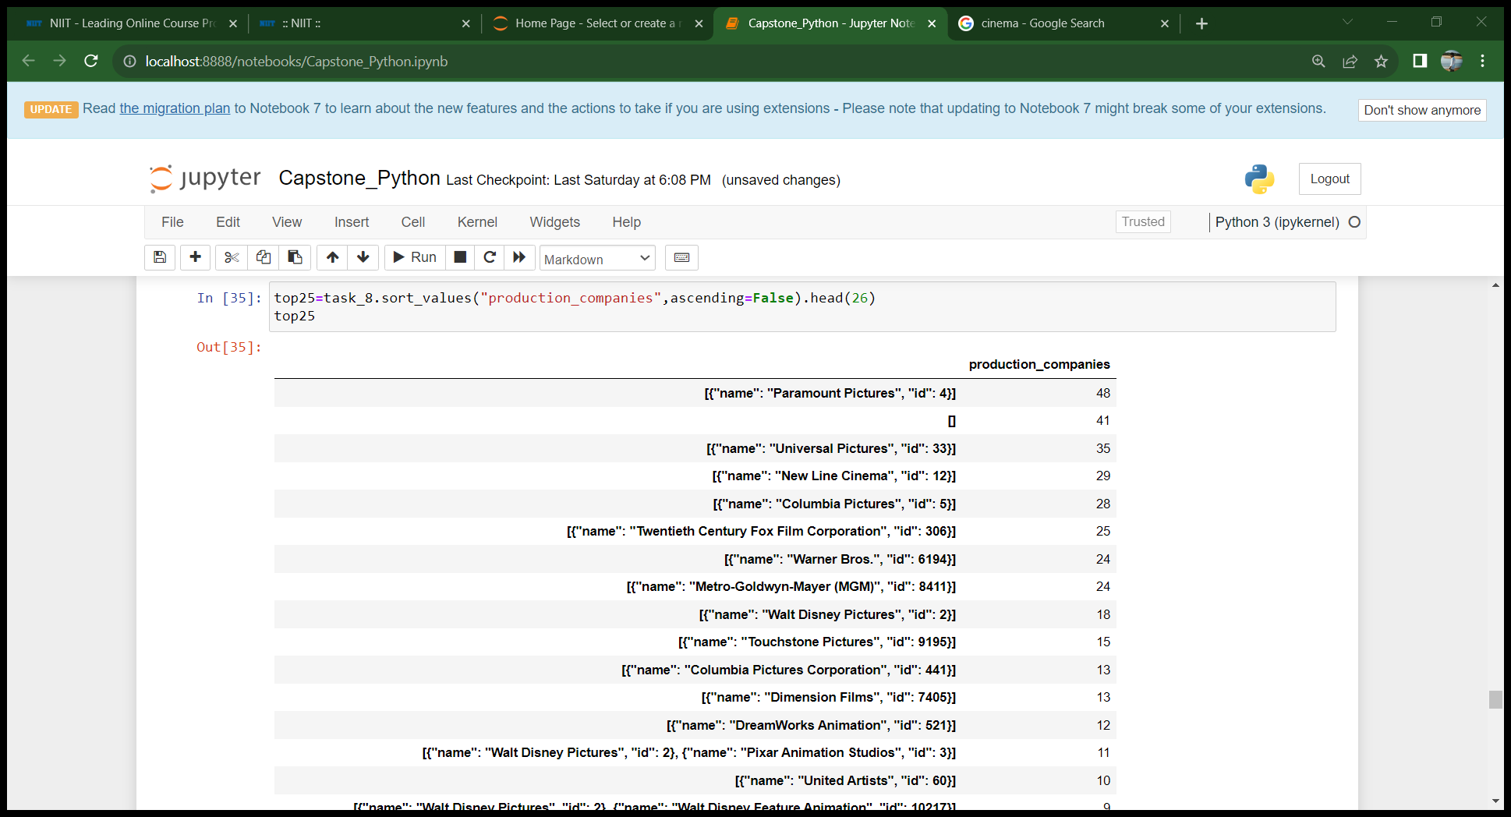
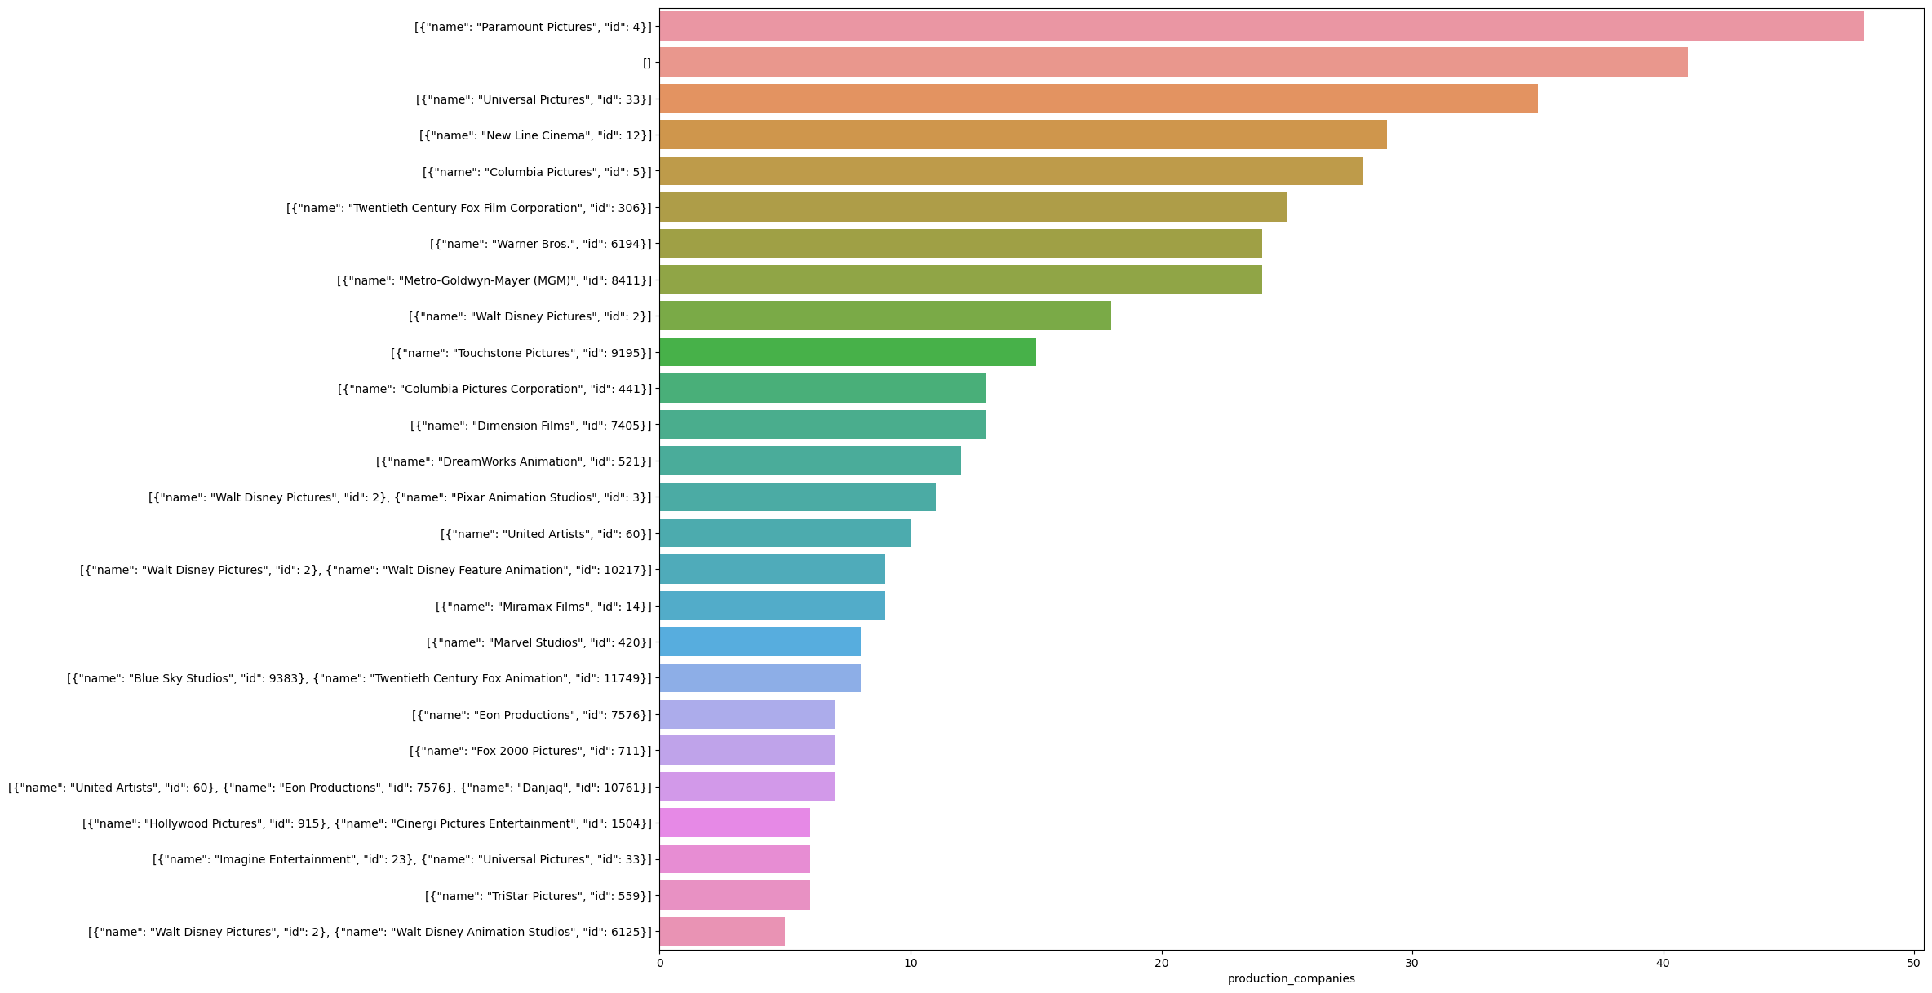
Task 9
display the names of top 25 production companies based on the number of movies they have produced in descending order of the number of movies produced
Paramount has higher number of movies

Slide 13
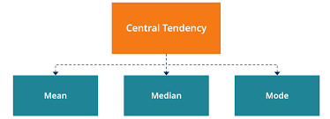
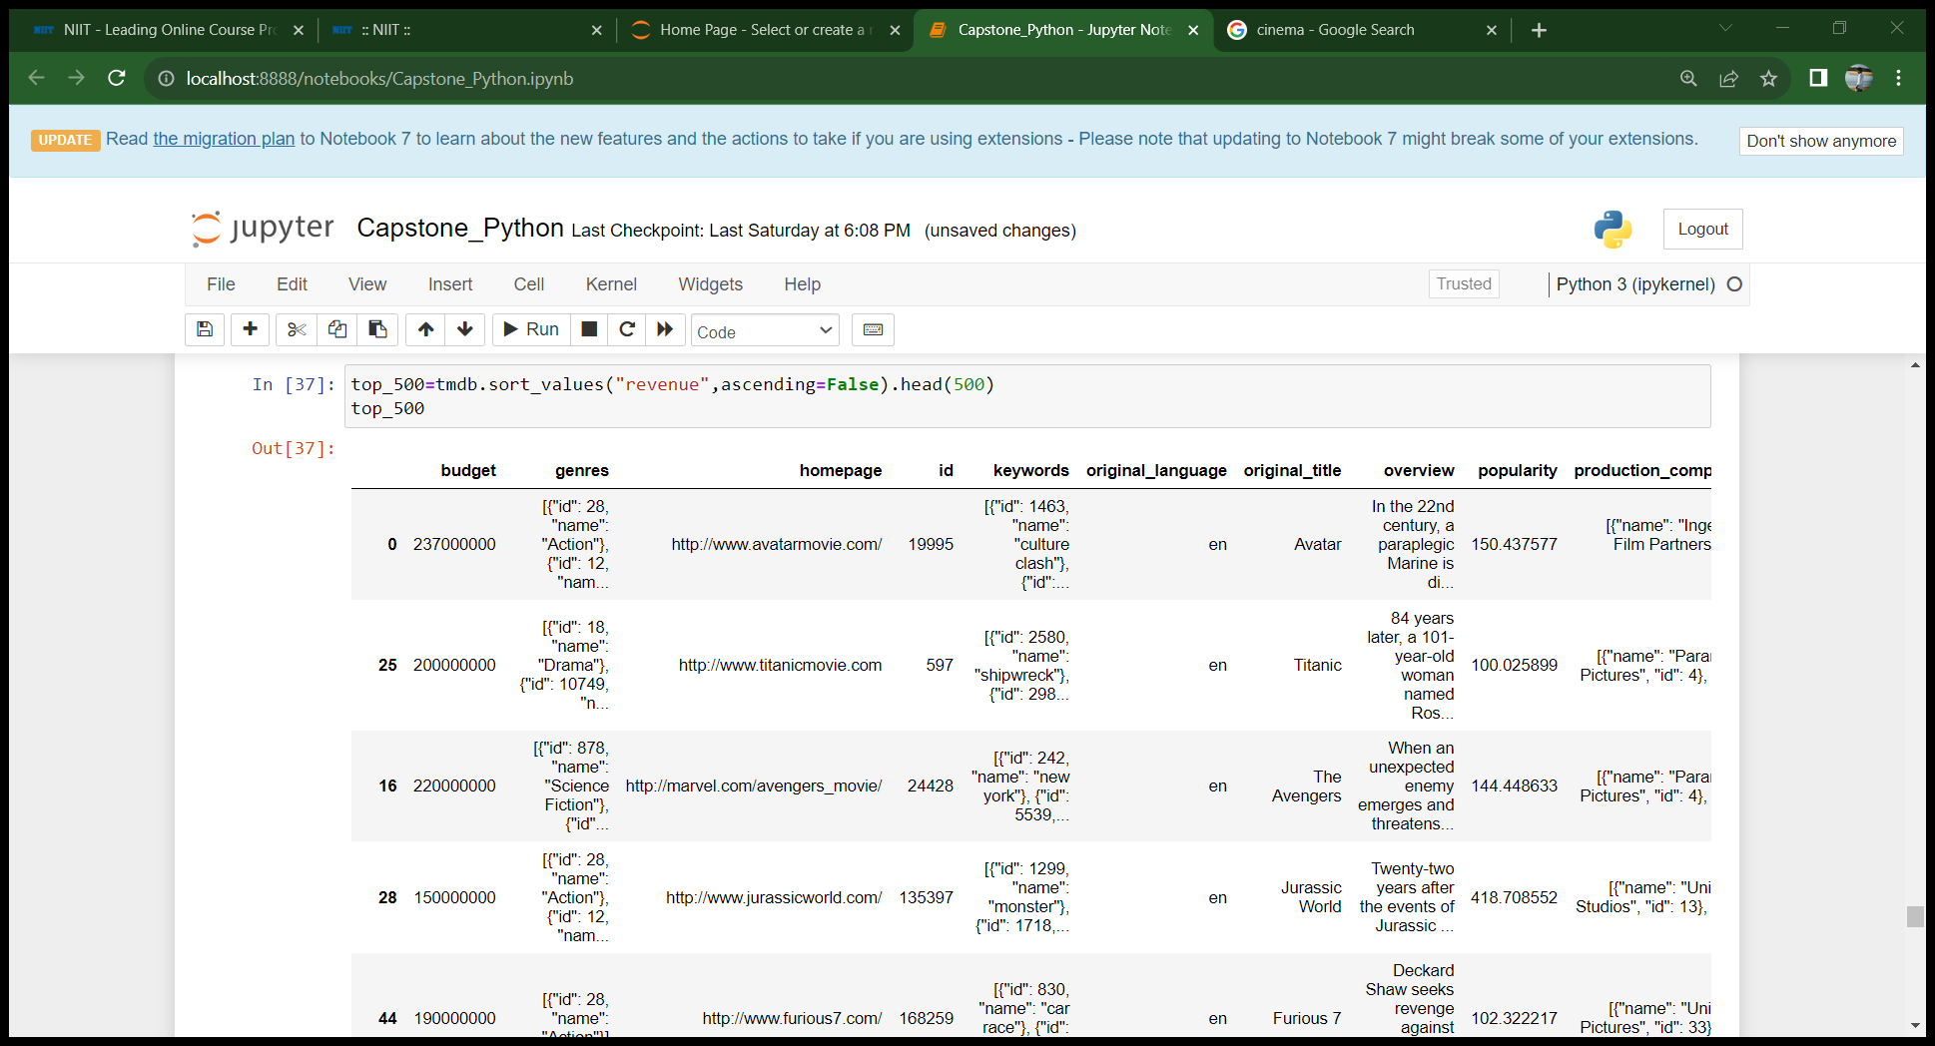
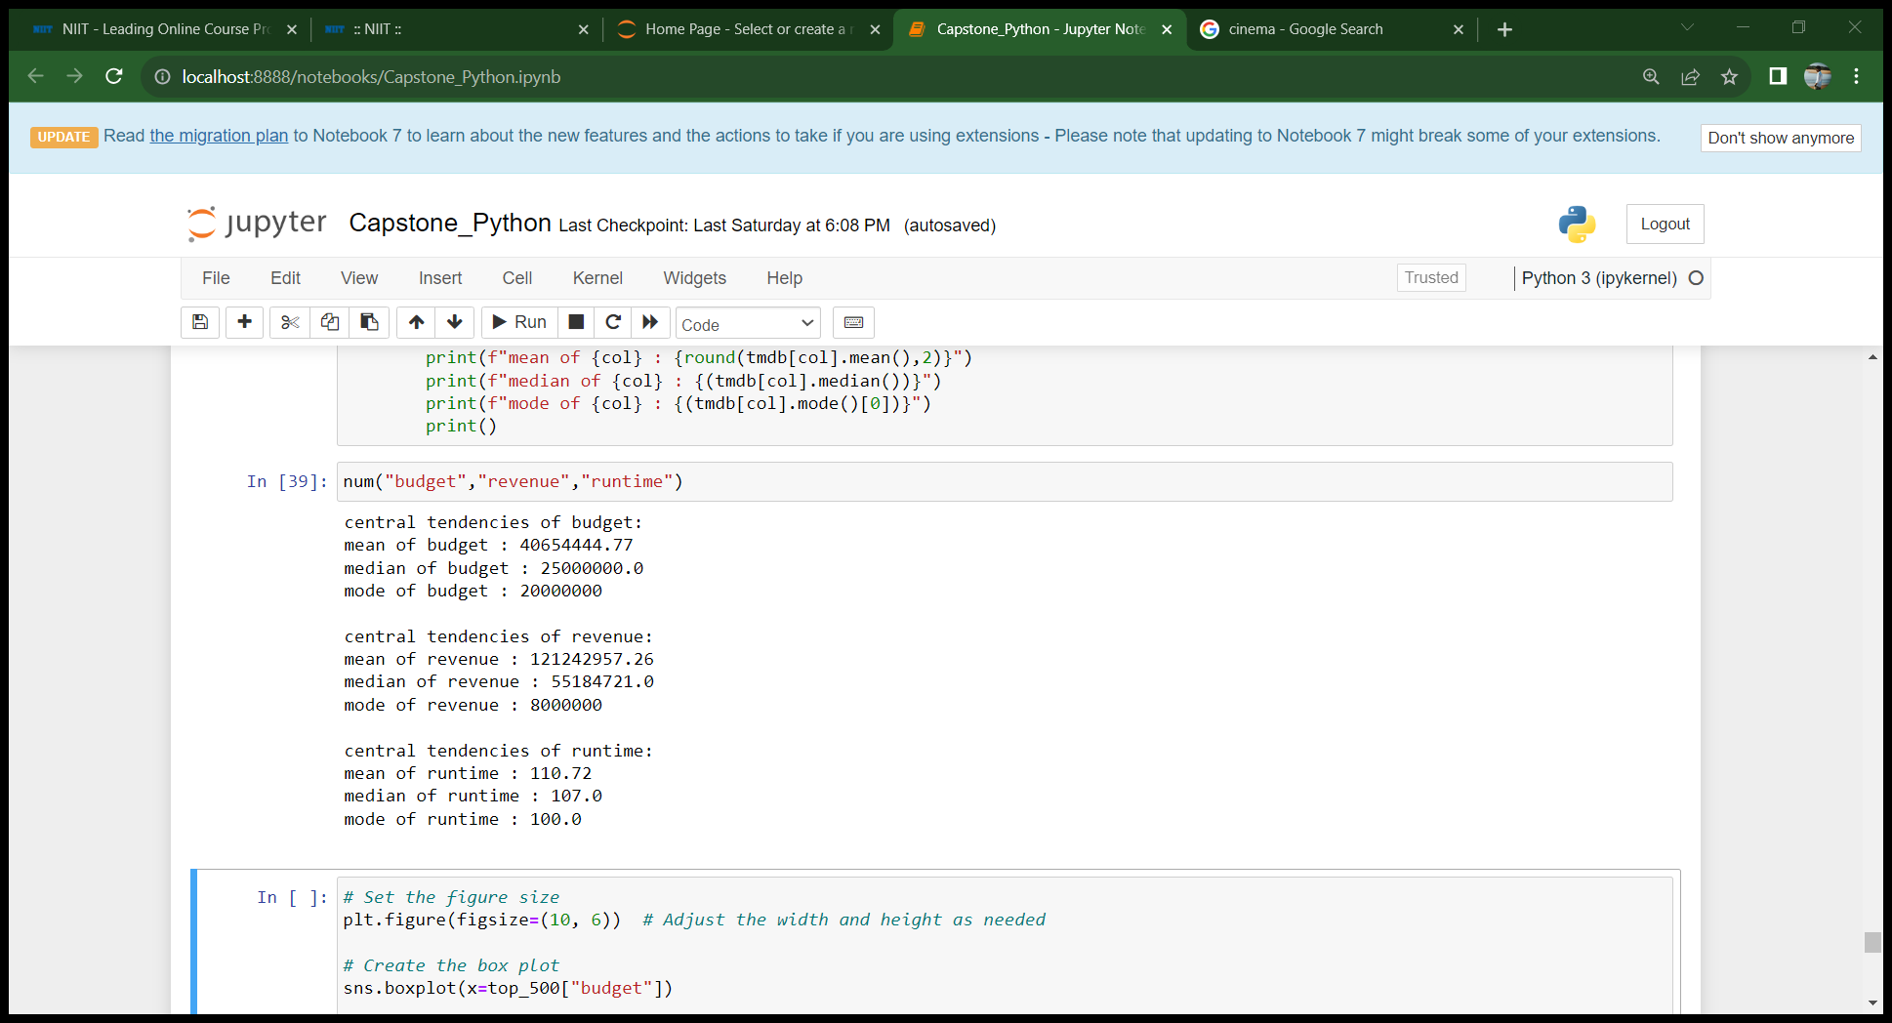
Task 10
Sort the data in descending order based on revenue and filter top 500 movies . Find the measures of central tendencies using
Budget
Revenue
Run time

Slide 14

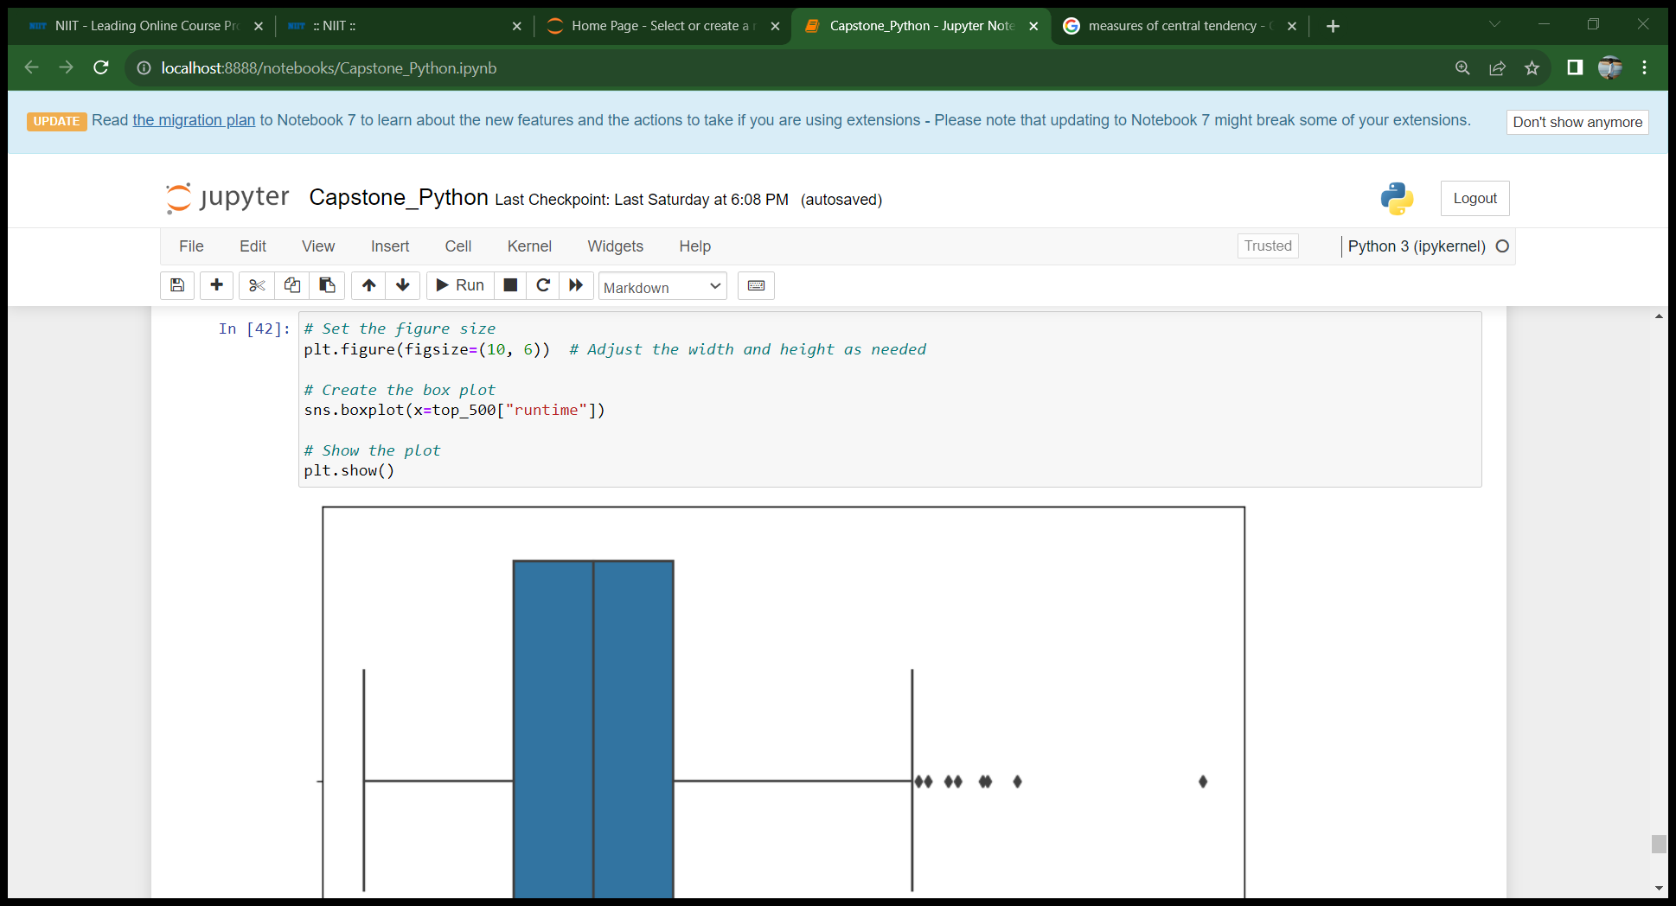
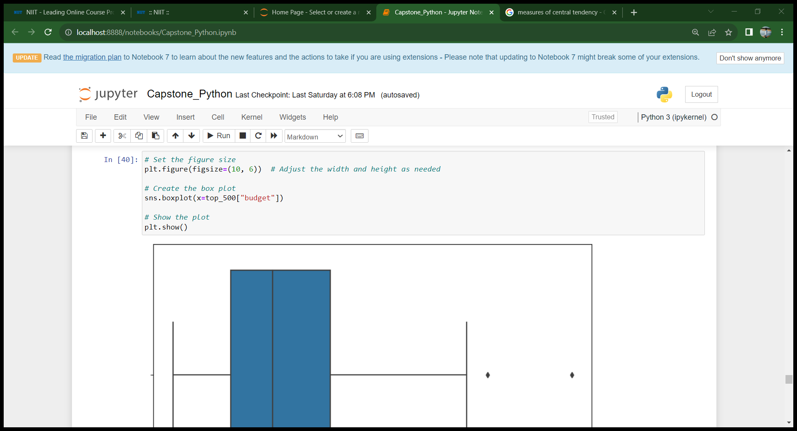
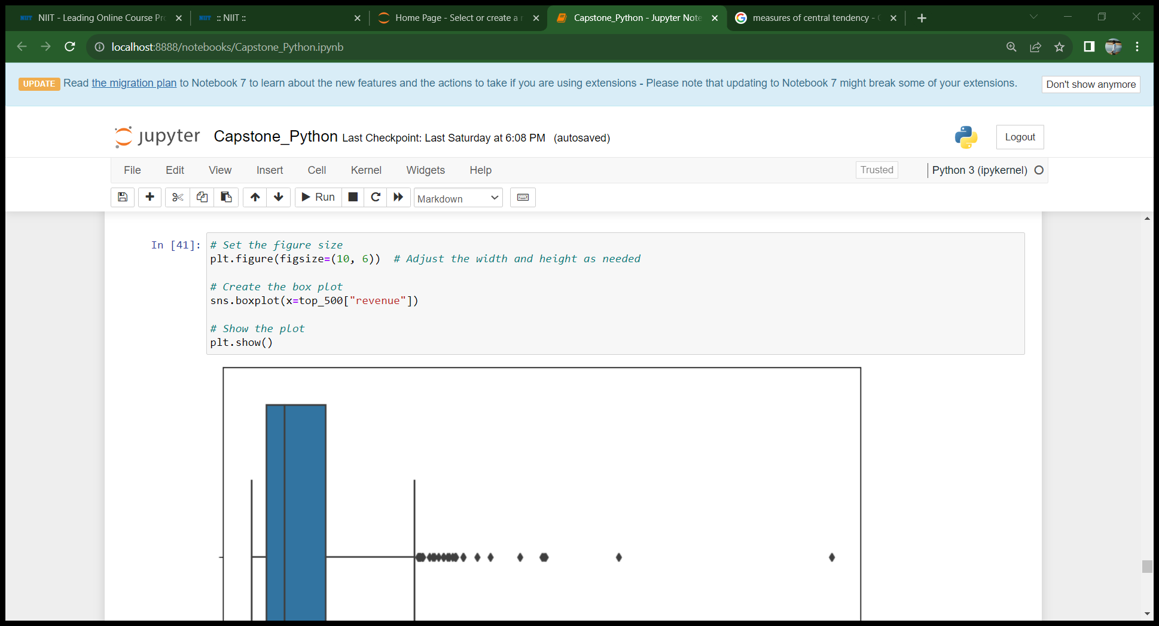
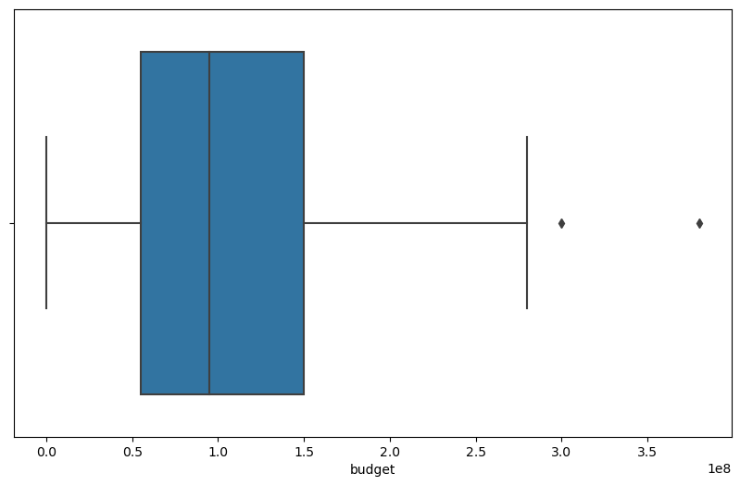
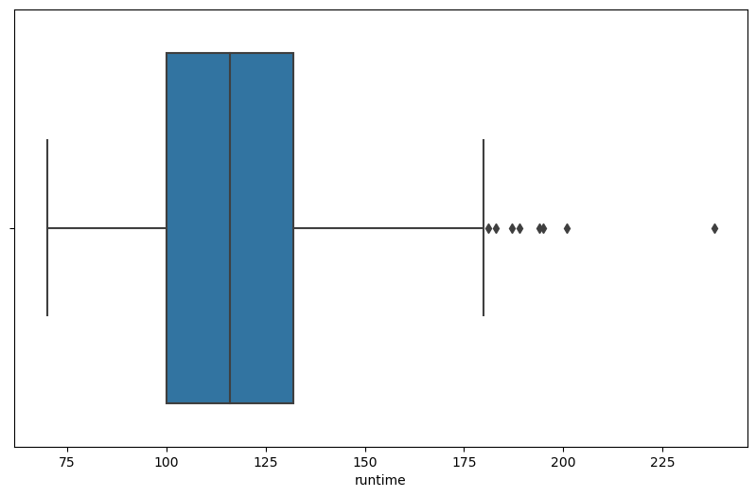
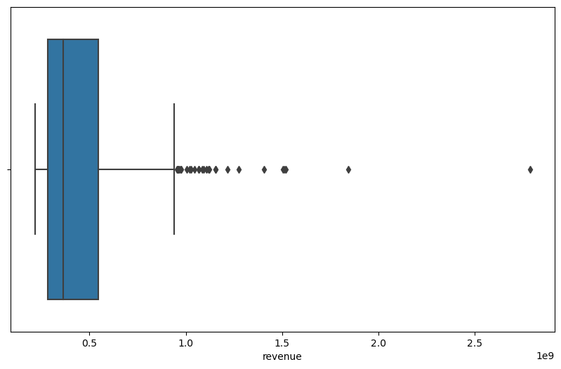
Task 10
Sort the data in descending order based on revenue and filter top 500 movies . Find the measures of central tendencies using
Budget
Revenue
Run time - with outlier analysis
50% of all the movie revenue are lying between 0 to 20,000,000, and more than 40,000,000 are outliers
50% of all the movie runtime are lying between 95 to 130 min and more than 155 min and less than 60 min are outliers.
50% of all the movie budgets are lying between 0 to 50,000,000 and more than 120,000,000 are outliers.

Slide 15

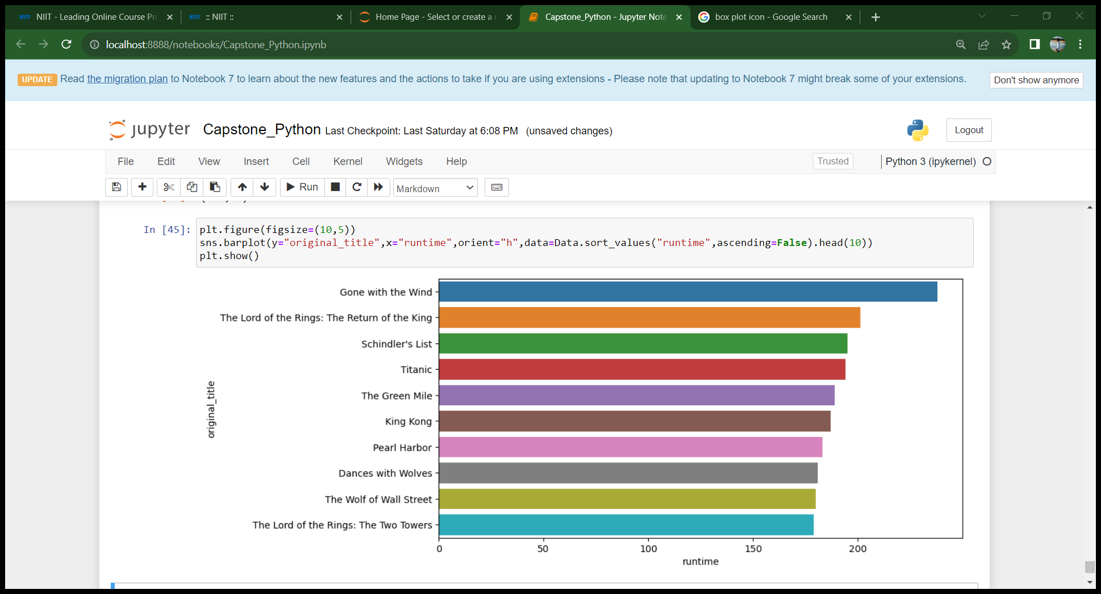
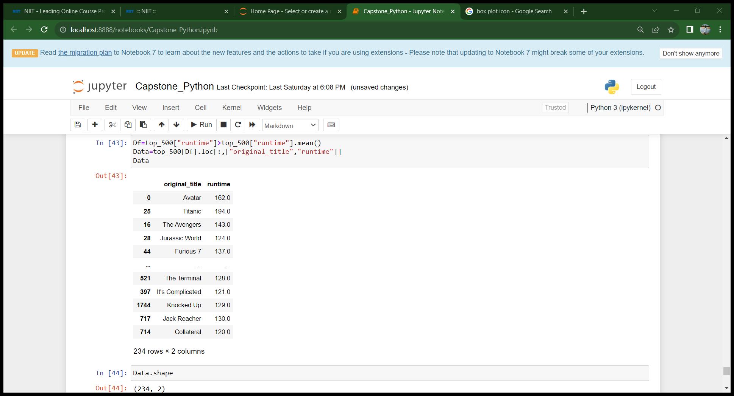
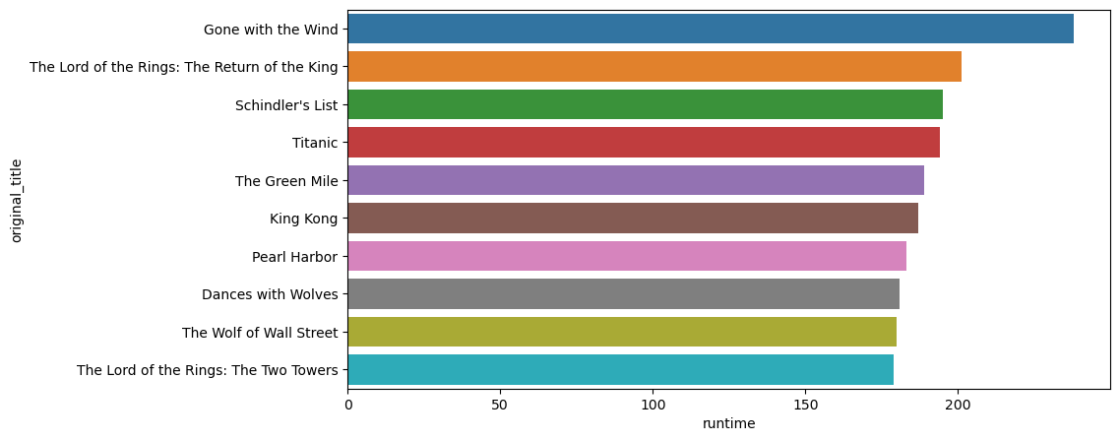
Task 11
Identify and display the names of the movies along with their runtimes for those movies that have above average run time from previous task
Gone with the wind has the highest runtime

Slide 16
summary
Adventure, Action and Fantasy have highest budget over all the movie categories.
Adventure, Action , Fantasy and Science fiction have highest revenue over all the movie categories.
Avatar movie has all-time highest revenue.
Modern Times movie is all-time lowest budget film.
Movie popularity and Budget have weak and positive correlation.
Paramount pictures production company has the highest number of movies (Around 48).
Gone with the wild movie has highest runtime among top 500 movies based on revenue.

Slide 17
THANK YOU

